Slide 1
KOTLIN CONCEPTS

Slide 2
TODAY’S AGENDA
Kotlin Concepts – Lambda, HOC with collections

Slide 3
LAMBDA
A lambda (sometimes called a “lambda expression”) is a kind of concise mini-function which can be used directly as a value: a lambda is the equivalent of an anonymous function (a function that has no name) without the fun keyword.
// Lambda
{ println("Hello, everyone!") }
// Anonymous function
fun() { println("Hello, everyone!") }

Slide 4
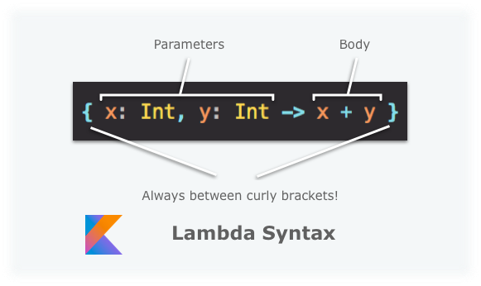
In Kotlin, a lambda will be treated by the compiler in the same way as an anonymous function: these two syntaxes are therefore equivalent. Let’s take a closer look at the lambda syntax:
Thinking of a lambda as a mini-function will really help you understand how it works. And, like a normal function, a lambda expression will have parameter(s) and a body, all between brackets.

Slide 5
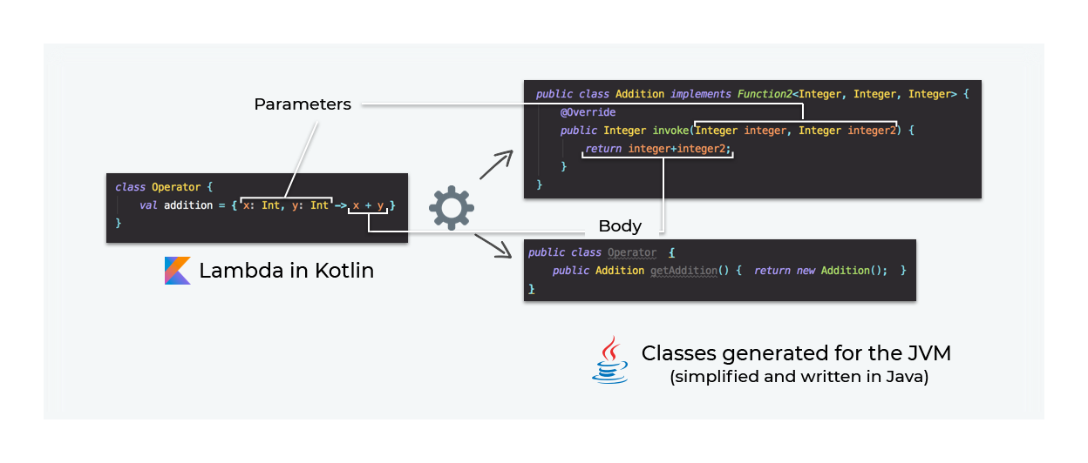

Slide 6
our previous addition value containing a lambda can be called in Kotlin AND Java without any problem!
val result = Operator().addition(10, 2)
println(result)
int result = new Operator().getAddition().invoke(10, 2);
System.out.println(result);

Slide 7
Let’s play with lambdas: higher order functions
One day, you’ll have to use lambdas as parameters of a method! Imagine, for example, that you want to create a super calculator only using lambdas. We’ll start by creating variables containing different operations such as addition, subtraction, and division:
val addition = { x: Int, y: Int -> x + y }
val subtraction = { x: Int, y: Int -> x - y }
val division ! { x: Int, y: Int -> x / y }
So far, so good. Now we will create a function that can contain another function as a parameter: these kinds of functions are called higher-order functions.

Slide 8
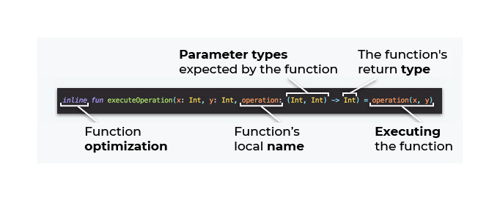

Slide 9
Here we’ve created a function called executeOperation which takes three parameters as input: two Integer variables and a function. The function will be executed in the body of the method.
So, using this executeOperation function, we can pass a function as a parameter to obtain this type of result:
executeOperation(10, 4, addition) // Result = 15
executeOperation(5, 2, subtraction) // Result = 3
executeOperation(10, 2, division) // Result = 3

Slide 10
Amazing, isn’t it? The fact that we can pass a function as a parameter to another one opens the doors to a world we didn’t really know: the world of functional programming!
Now we’re passing a function (in its lambda form) stored in a variable, but be aware that you can also pass a lambda directly
// Multiplication
print(executeOperation(10, 5, { x, y -> x * y } )) // Result = 50
All this is great! But what does the inline keyword mean in our executeOperation function?
When we create a higher-order function in Kotlin, the Kotlin compiler will create—as we saw above—one or more Function classes representing our lambdas. This instantiation has an impact on memory because, for each lambda created, a Function object will also be created.
The inline keyword tells Kotlin to skip creating a Function object representing the lambda, and instead to move its code directly to where we will execute it:
So, in general, if you decide to create a higher-order function in your program, always remember to add the inline keyword to optimize memory usage in your program.

Slide 11
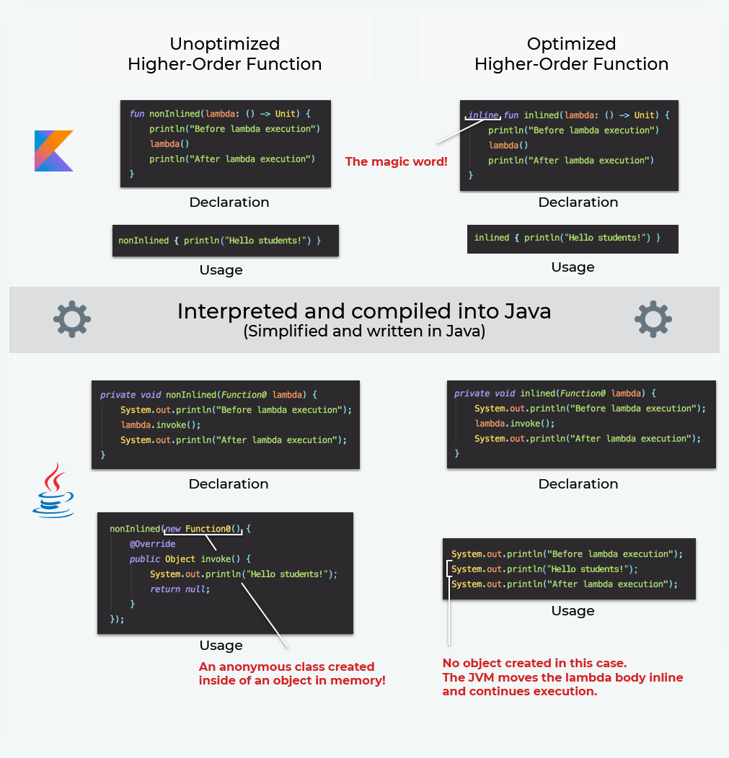

Slide 12
Grouping Actions
Sometimes we perform certain actions one after the other on the same object, especially for construction and configuration purposes. In Java, we were used to using the Builder pattern.
In Kotlin, we can use the higher-orderapply()function to group together actions on the same object, also

Slide 13
OPERATOR OVERLOADING
In Kotlin, we can add an element to a list using the + operator. In the same way, we can add two strings together. We can check if a collection contains an element using the in operator. We can also add, subtract or multiply elements of type BigDecimal, which is a JVM class that is used to represent possibly big numbers with unlimited precision.
Using operators between objects is possible thanks to the Kotlin feature called operator overloading, which allows special kinds of methods to be defined that can be used as operators.

Slide 14
Let's say that you need to represent complex numbers in your application. These are special kinds of numbers in mathematics that are represented by two parts: real and imaginary. Complex numbers are useful for a variety of kinds of calculations in physics and engineering.
In mathematics, there is a range of operations that we can do on complex numbers. For instance, you can add two complex numbers or subtract a complex number from another complex number. This is done using the + and - operators. Therefore, it is reasonable that we should support these operators for our Complex class. To support the + operator, we need to define a method that has an operator modifier that is called plus and a single parameter. To support the - operator, we need to define a method that has an operator modifier called minus and a single parameter.

Slide 15
Operator overloading is a form of polymorphism. Some operators change behaviors on different types. The classic example is the operator plus (+). On numeric values, plus is a sum operation and on String is a concatenation. Operator overloading is a useful tool to provide your API with a natural surface. Let’s say that we’re writing a Time and Date library; it’ll be natural to have the plus and minus operators defined on time units.

Slide 16
Binary operators
Binary operators
Binary operators receive a parameter (there are exceptions to this rule—invoke and indexed access).
The Pack.plus extension function receives a Wolf parameter and returns a new Pack. Note that MutableMap also has a plus (+) operator:

Slide 17
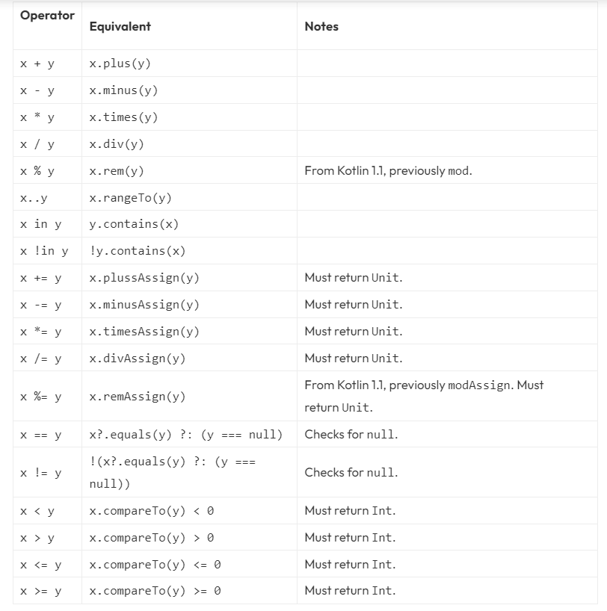

Slide 18
Invoke
When we introduce lambda functions, we show the definition of Function1:
/** A function that takes 1 argument. */
public interface Function1<in P1, out R> : Function<R> {
/** Invokes the function with the specified argument. */
public operator fun invoke(p1: P1): R
}
The invoke function is an operator, a curious one. The invoke operator can be called without name.

Slide 19
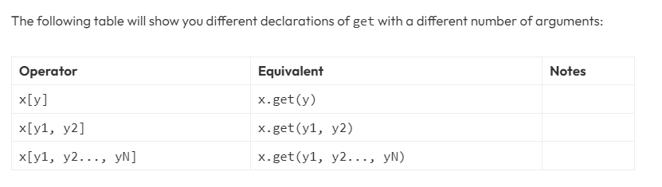
Indexed access
The indexed access operator is the array read and write operations with square brackets ([]), that is used on languages with C-like syntax. In Kotlin, we use the get operators for reading and set for writing.
With the Pack.get operator, we can use Pack as an array:

Slide 20
Few Important Points
1. When you overload operators, you should try to maintain the original spirit of the operator.
2. Unlike languages like Scala, only a specific set of operators can be overloaded in Kotlin.
3. If your class:
represents a single action
is named for a specific action
then go for it!

Slide 21
To summarize the documentation the following can be overloaded:
+a a.unaryPlus()
-a a.unaryMinus()
!a a.not()
a++ a.inc()
a-- a.dec()
a + b a.plus(b)
a - b a.minus(b)
a * b a.times(b)
a / b a.div(b)
a % b a.rem(b), a.mod(b) (deprecated)
a..b a.rangeTo(b)
a[i] a.get(i)

Slide 22
a[i, j] a.get(i, j)
a[i_1, ..., i_n] a.get(i_1, ..., i_n)
a[i] = b a.set(i, b)
a[i, j] = b a.set(i, j, b)
a[i_1, ..., i_n] = b a.set(i_1, ..., i_n, b)
a() a.invoke()
a(i) a.invoke(i)
a(i, j) a.invoke(i, j)
a(i_1, ..., i_n) a.invoke(i_1, ..., i_n)
a += b a.plusAssign(b)
a -= b a.minusAssign(b)
a *= b a.timesAssign(b)

Slide 23
a /= b a.divAssign(b)
a %= b a.remAssign(b), a.modAssign(b) (deprecated)
a == b a?.equals(b) ?: (b === null)
a != b !(a?.equals(b) ?: (b === null))
a > b a.compareTo(b) > 0
a < b a.compareTo(b) < 0
a >= b a.compareTo(b) >= 0
a <= b a.compareTo(b) <= 0

Slide 24
Generics are used when we want to create a generic data structures independent of Data Type. Say you want to represent a class or function for your new algorithm, and you want that to work for Integers, Floating points, Strings etc, you can use generics to achieve the same.

